Slide 1




VASAVI ENTERPRISE
JUN 20 2025
DRIVING SALES GROWTH
With Data

Slide 2


PROJECT SCHEDULE
01

Slide 3

Executive Summary
Analysed customer sales data across 2.5 years (2023–2025)
Applied RFM analysis + K-Means clustering
Identified 4 segments: 🥇 VIP, 💼 Regular, 🔄 One-time, 🎯 Location-focused
Proposed a focused marketing strategy for the next 6 months

Slide 4

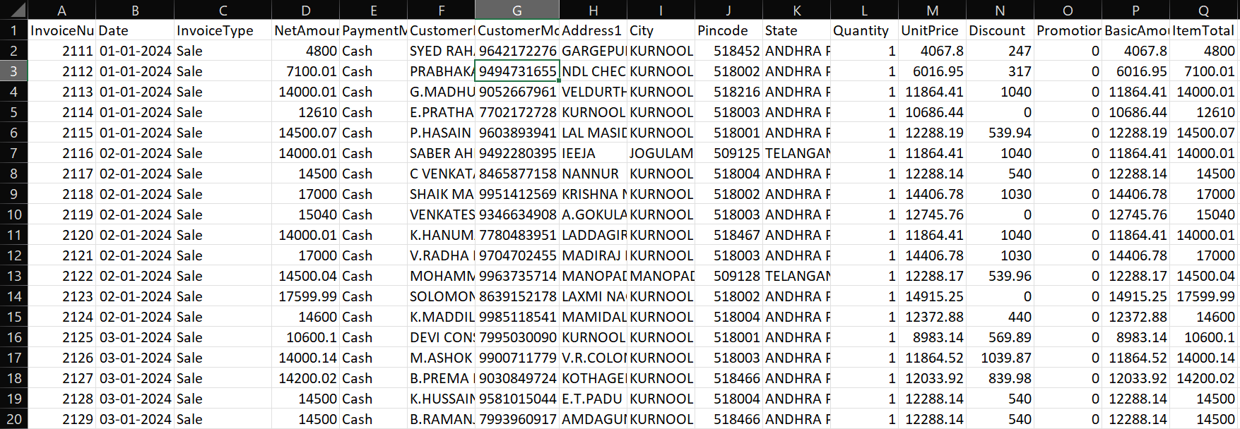

Data Overview

Slide 5
Project Achievements
01
02
Elaborate on what you want to discuss.
Elaborate on what you want to discuss.
03
04
Elaborate on what you want to discuss.
Elaborate on what you want to discuss.

Slide 6


TOP SALES
02
TOP SALES OF CITY AND STATE

Slide 7

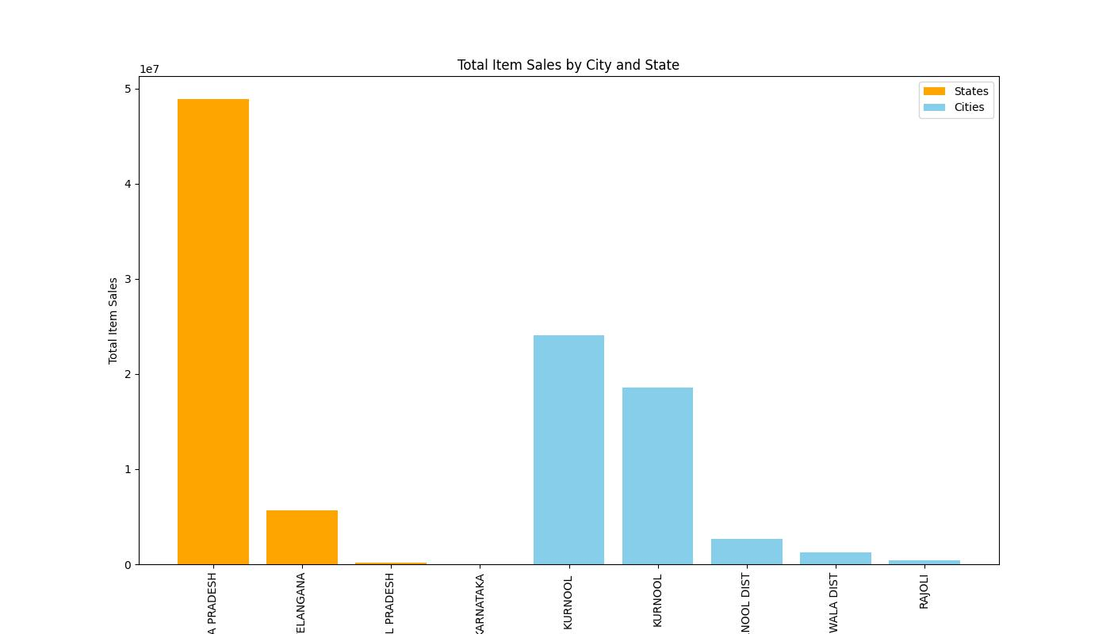
Top Sales
Sales 2023

Slide 8
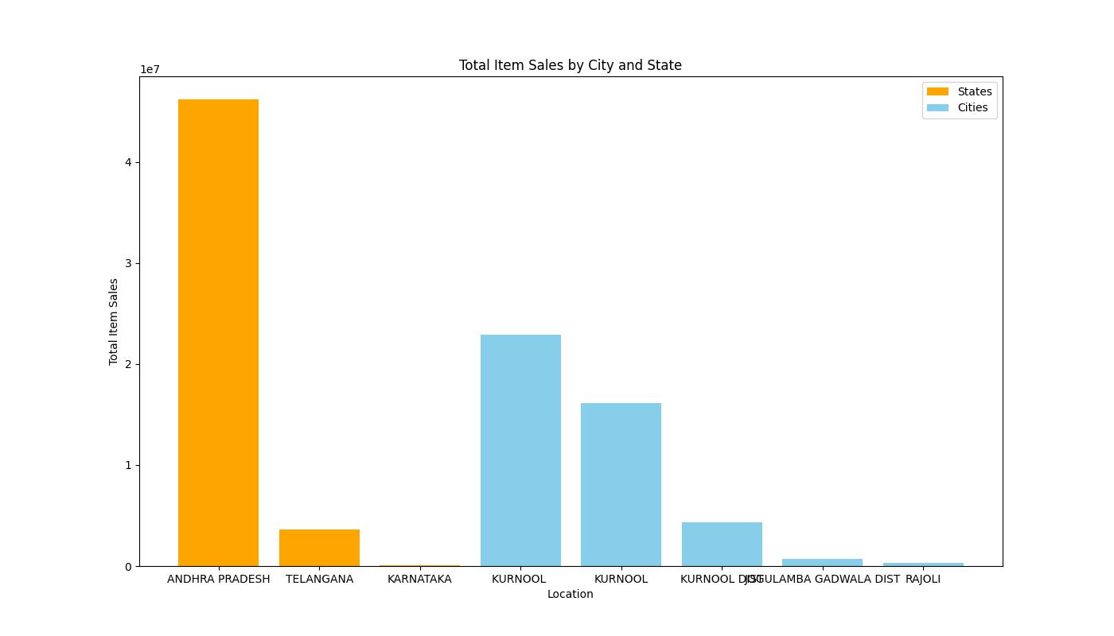
Top Sales
Sales 2024

Slide 9
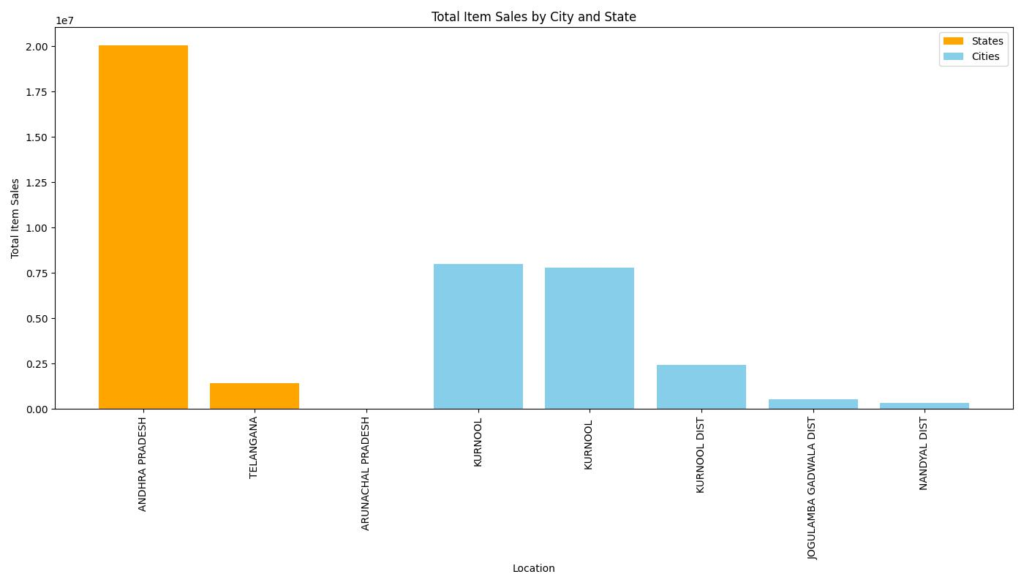
Top Sales
Sales 205

Slide 10

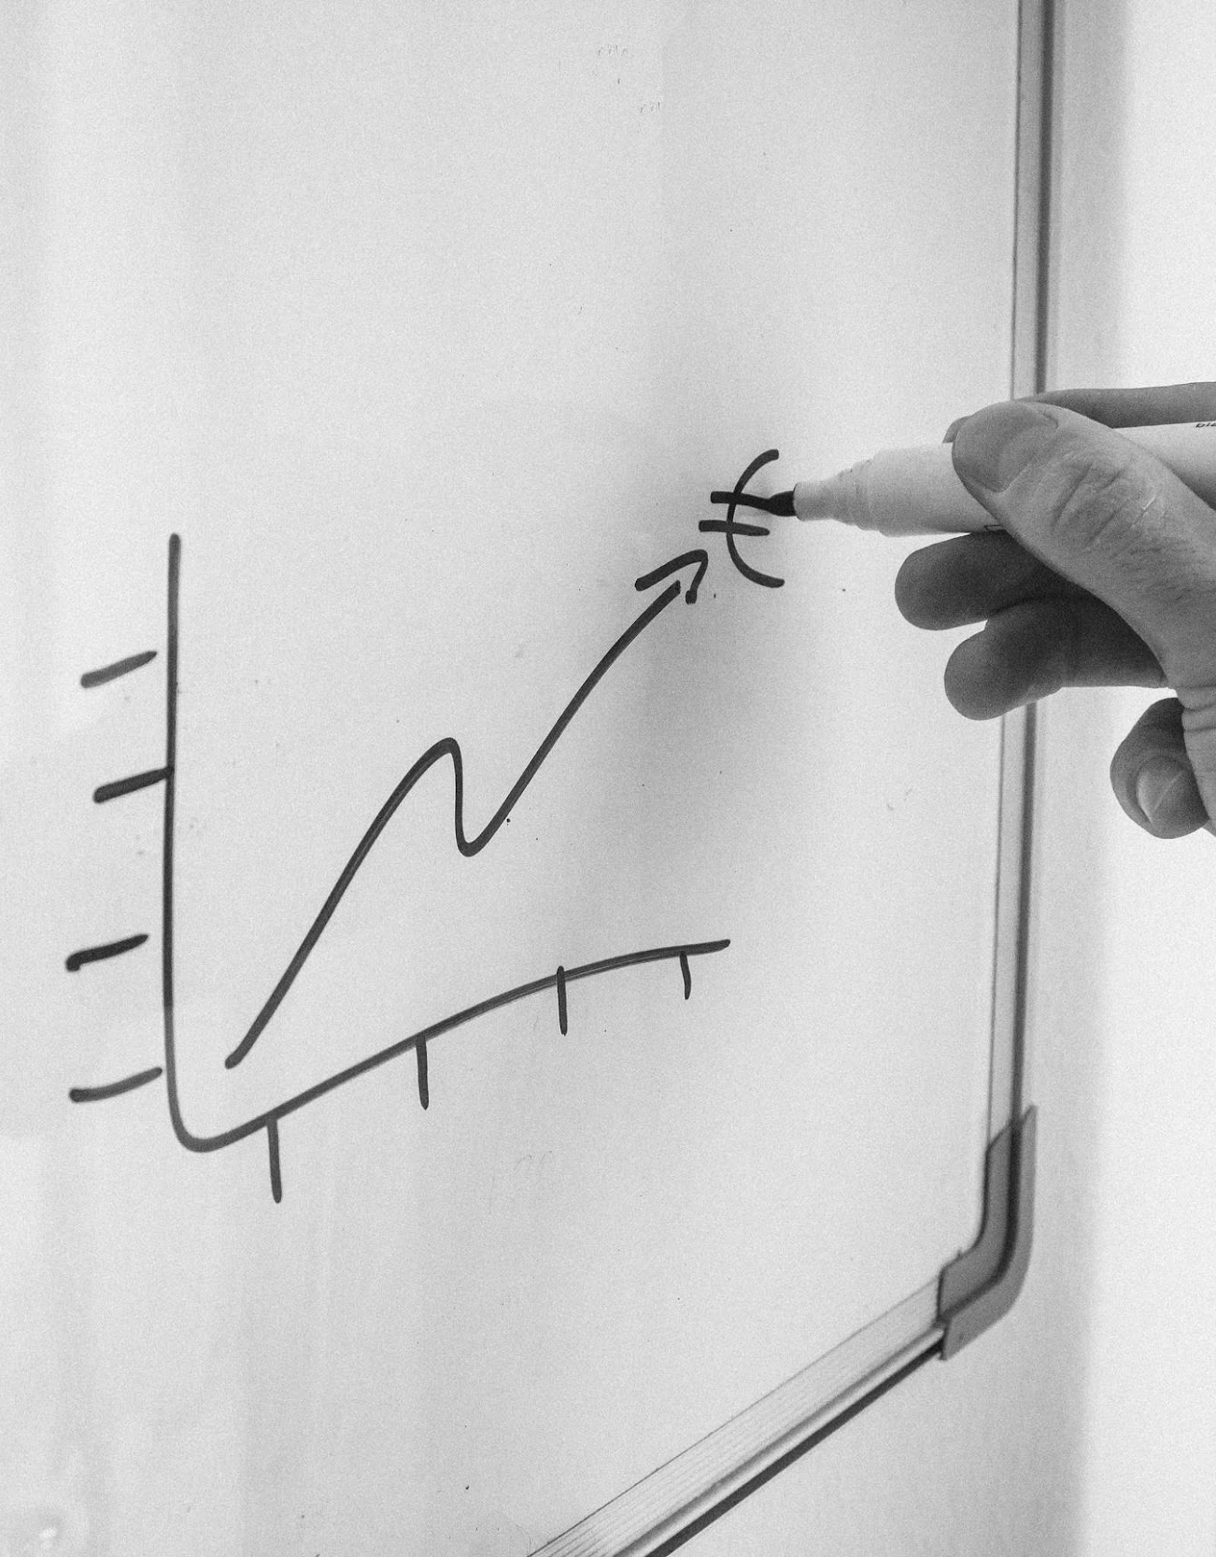
Segment Distribution
03
Segment Distribution by year

Slide 11

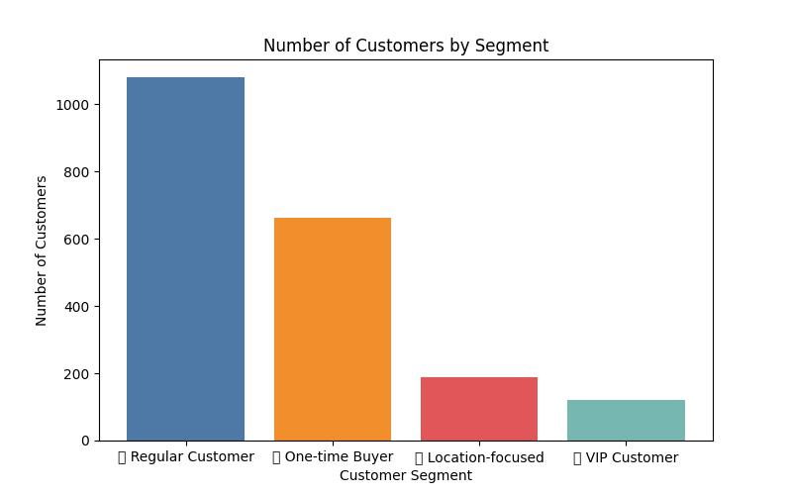
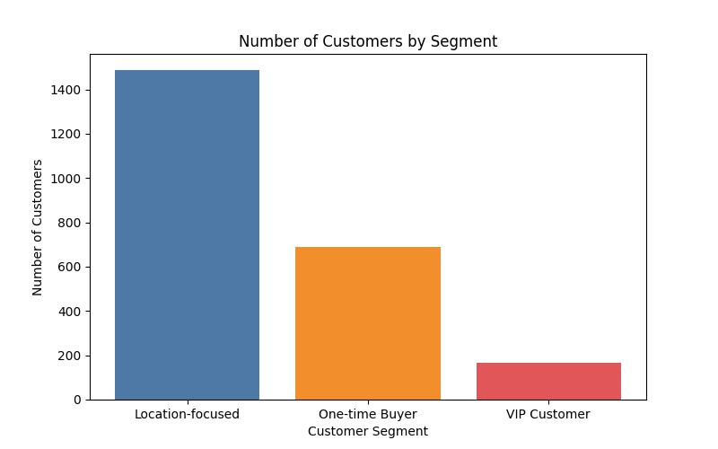
Segment Distribution by Year
Segment 2023
Segment 2024

Slide 12
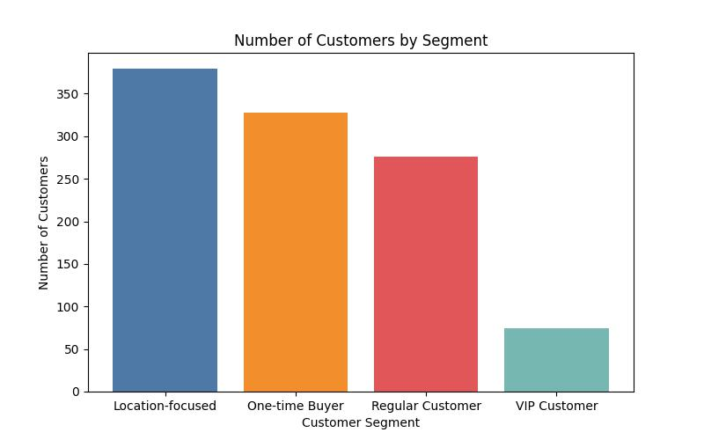
Segment Distribution by Year
Segment 2025
VIP Customer: Most valuable customers who purchase regularly and spend the most.
Regular Customer: Consistent buyers but not high spenders.
One-time Buyer: Low engagement and low spend.
Location-focused: May not spend much but show regional loyalty.

Slide 13

THANK YOU

